Slide 1
FOREST FIRE DETECTION USING IMAGE PROCESSING
Group Members:
B. Laxmi Nitin Singh (19BCE1289)
V. Keshava Sai Kumar (19BCE1843)
Mourya Vardhan Reddy (19BCE1533)

Slide 2
INTRODUCTION
Forest fire detection systems are gaining a lot of attention because of the continual threat from fire to both economic properties and public safety [1]. Hundreds of millions of hectares are destroyed by wildfires each year [2] and over 200,000 forest fires happen every year in the world. Forest fires destroy a total area of 3.5 to 4.5 million km2 [3]. Increase in forest fires in forest areas around the world has resulted in an increased motivation for developing fire warning systems for the early detection of wildfires [1]. Sensor technology has been widely used in fire detection, usually depending on sensing physical parameters such as changes in pressure, humidity, and temperature, as well as chemical parameters such as carbon dioxide, carbon monoxide, and nitrogen dioxide. However, it is hard to apply these systems in large open areas for a variety of reasons such as high cost, energy usage by the sensors, and the necessary proximity of the sensor to the fire for accurate sensing resulting in physical damage to the sensors [4]. In addition, sensor methods have a high false alarms rate and their response time is quite big [5].

Slide 3
There are numerous motivating factors for the use of an image processing based method of fire detection. The first factor is the rapid development of digital camera technology and CCD or CMOS digital cameras, which has resulted in a rapid increase in image quality and decreased cost of the cameras. The second factor is that digital cameras can cover large areas with excellent results. Third, the response time of image processing models is better than that of existing sensor models. Finally, the overall cost of image processing systems is lower than existing systems.

Slide 4

MODULES
1. Movement Containing Region Detection Based on Background Subtraction (MRDB).
Detecting moving regions is a key factor in most of the video based fire detection systems because fire boundaries continuously fluctuate. So background subtraction is used to select candidate regions of fire. A pixel located at (x, y) is supposed to be moving if the following condition is satisfied

Slide 5
𝐼_{𝑛}(x, y) represents the intensity value of the pixel at location (x, y) in the nth gray-level for the current frame and B_{n} (x, y) represent the background intensity value at the same pixel location, and thr is a threshold value experimentally set to 3.
The background is continuously updated using:
B_{k + 1}(x, y) = 𝞪 * B_{k}(x, y) + (1 − 𝞪) * I_{k}(x, y)
Where 𝞪 ε (0, 1)

Slide 6
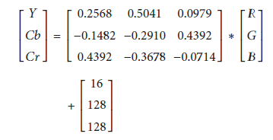
2. Converting RGB Images to YCbCr
Due to the fact that different kinds of moving objects can be included after applying background subtraction, such as trees, animals, birds, and people, therefore images from the background subtraction stage are converted to YCbCr [9] to select candidate fire regions using

Slide 7
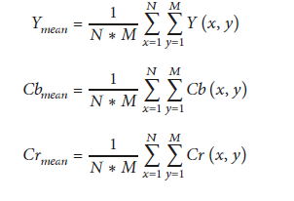
The mean values of the YCbCr channel are then calculated using

Slide 8

3. Fire Color Pixel Detection Rules
In any fire image pixels, the red color value is larger than green and green is larger than blue as illustrated in Figure 4: (a) is a fire image and (b) is the RGB channels histogram for the same image.This fact is represented in RGB color space as R>G>B and can be converted to YCbCr using the following equations:

Slide 9
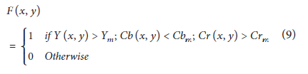
Also, the Y component value is greater than the mean Y component of the same image and the Cb component is smaller than the mean Cb of same image, while the Cr component is greater than the mean Cr mean component. This fact can be represented by the flow:

Slide 10
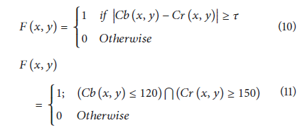
where F(x, y) can be any pixel on the image. Y_{𝑚}, Cb_{𝑚}, and Cr_{𝑚} are the mean values for Y, Cb, and Cr, respectively.
The Cb component as shown is predominantly “black” and the Cr component is “white”. This idea can be represented by the following equations:

Slide 11
where 𝜏 is a constant, specified in [10] using receiver operating characteristic (ROC), by applying different values of 𝜏 in the range [1, 100]. To measure the “true detection rate” and “false detection,” data sets consisting of 500 images (300 of them being images of a forest fire, 200 non fire images) collected from Internet were used. Only (10) was used with different values of 𝜏 in the range [1, 100] to detect binary images of the candidate fire region. 𝜏 was selected as 𝜏 = 70 resulting in a true detection rate of more than 90% and false detection of less than 40%.

Slide 12

4. Temporal Variation
Using color models alone is not enough to identify fire correctly because there are several objects that share the same fire color such as red leaves, desert, and other red moving objects. The main difference between actual fire and the fire-color objects is the nature of their motion. Shape and size of the flame are totally changeable, because of burning materials and airflow; thus, it produces higher temporal variation. In contrast, rigid bodies’ motion produces lower temporal variation. Therefore, it is possible to differentiate between the fire pixels and the fire color. To detect a fire movement, the difference between successive frames was analyzed. Suppose a video sequence consisting of n frames, and the average temporal variation is defined as

Slide 13
where Δ(x, y) is the average temporal variation, 𝑓_{𝑖}(x,y) is a pixel intensity at the location (x, y) in the ith frame. If Δ(x, y) >thr (experimentally determined threshold), then a moving pixel is fire.

Slide 14
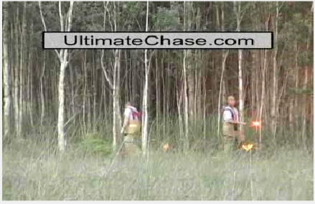
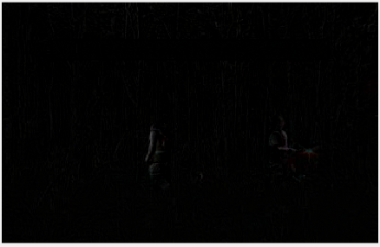
RESULT
Original Image After Background Subtraction

Slide 15

Original Image After Rule Based Detection

Slide 16
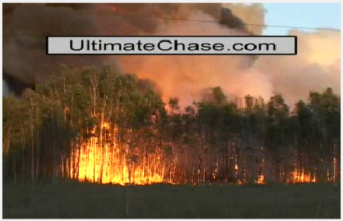

Original Image After Background Subtraction

Slide 17
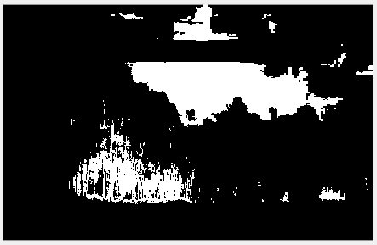
Original Image After Rule Based Detection

Slide 18
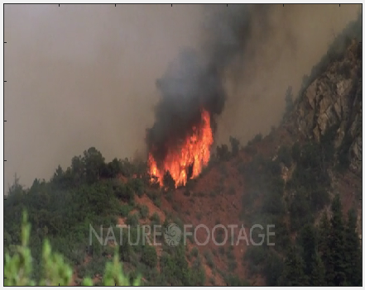
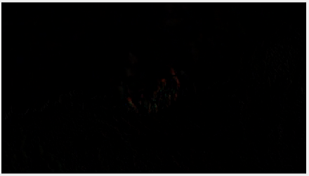
Original Image After Background Subtraction

Slide 19
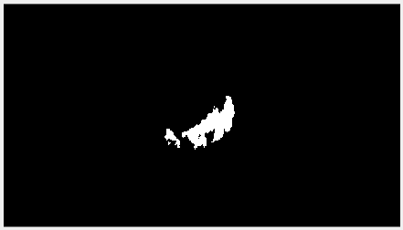
Original Image After Rule Based Detection

Slide 20
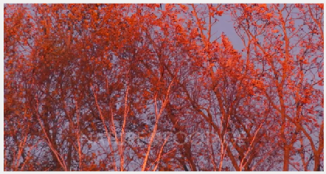

Original Image After Background Subtraction

Slide 21
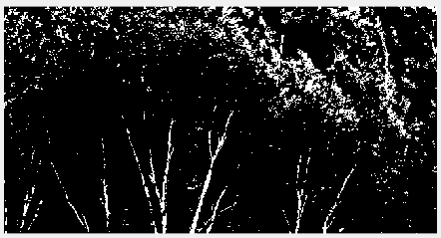
Original Image After Rule Based Detection

Slide 22
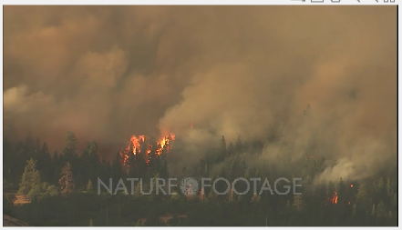

Original Image After Background Subtraction

Slide 23
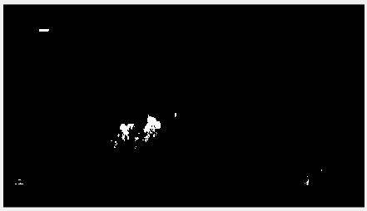
Original Image After Rule Based Detection

Slide 24
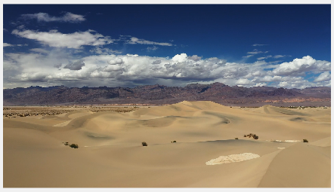

Original Image After Background Subtraction

Slide 25

Original Image After Rule Based Detection

Slide 26
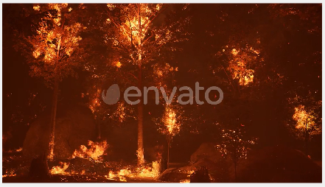
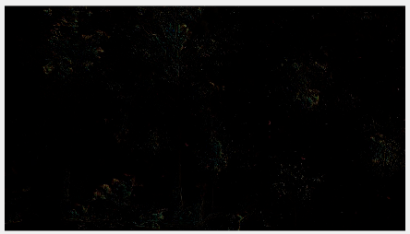
Original Image After Background Subtraction

Slide 27
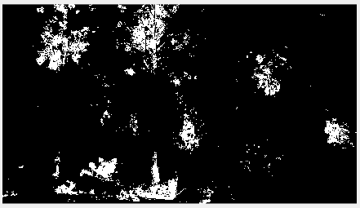
Original Image After Rule Based Detection

Slide 28
CONCLUSION
This study proposes an effective forest fire detection method by using image processing techniques including movement containing region detection based on background subtraction and color segmentation. The algorithm uses YCbCr color space which is better in separating the luminance from the chrominance and has a good detection rate. five fire detection rules are applied to detect the fire. The performance of the proposed algorithm is tested on a data set consisting of 7 videos collected from the Internet, five of which were actual fire videos, while two were fire-like objects videos. TP-rate and TN-rate were calculated.The results show that the proposed algorithm achieves good detection rates.These results indicate that the proposed method is accurate and can be used in automatic forest fire-alarm systems. For future work, the system could be improved by using a combination of rules of different color spaces; however, the challenge is selecting the right rules from different color spaces to build the method.

